Slide 1
Big Mountain Resort Data Analysis
Chris Dickerman

Slide 2
Table of Contents
Problem identification
Recommendation and key findings
Modeling results and analysis
Summary and conclusion

Slide 3
Problem Identification
Is Big Mountain pricing their tickets correctly?
What changes can be made to increase ticket price?

Slide 4
Modeling Results and Analysis
Collected data from all ski resorts in the country
Cleaned data by deleting zero columns
Cleaned data by discarding outliers
Identified main correlates of ticket price, namely
Total chairs
Snowmaking acres
Total vertical drop of the ski area

Slide 5
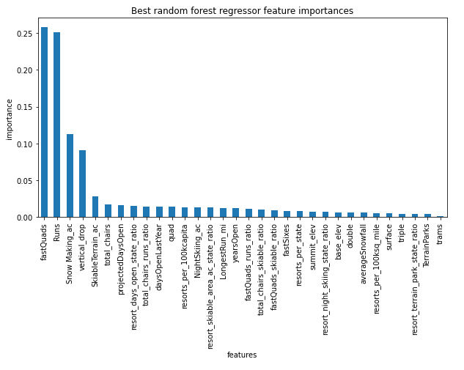
Modeling Results and Analysis
Optimized hyperparameters with gridsearch
Evaluated different models with 5-fold cross-validation
Random Forest achieved an R² = .71
Linear Regression achieved an R² = .63

Slide 6
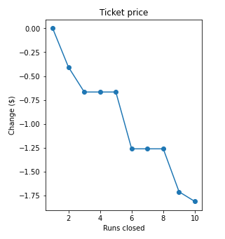
Testing Scenarios
Choose random forest due to better scores and smaller variance in predictions
We then run 3 scenarios through the model to predict price change
Scenario 1
Close up to 10 of the least used runs.
Results displayed in graph

Slide 7
Testing Scenarios
Scenario 2
Adding a run, increasing drop by 150 feet, and installing an additional chair lift
Result:
This scenario increases support for ticket price by $1.99
Over the season, this could be expected to amount to $3474638
Scenario 3
Adding a run, increasing drop by 150 feet, installing an additional chair lift, and adding 2 acres of snow making
Result :
This scenario increases support for ticket price by $1.99
Over the season, this could be expected to amount to $3474638
(No difference from scenario 2)

Slide 8
Testing Scenarios
Scenario 4
Increasing the longest run by 0.2 miles and guaranteeing its snow coverage by adding 4 acres of snow making capacity
Results: No predicted difference in price

Slide 9
Recommendations and Key Findings
Is Big Mountain pricing their tickets correctly?
Actual Price: $81 USD
Modeled Price: $95.87 USD [mean error 10.39]

Slide 10
Summary and Conclusion
Add a new run, increase the vertical drop by 150 feet, and install an additional chair lift
Close the least popular current run
Trial new ticket price of $95 USD

